Slide 1
The Lean-Fitness
Analogy
An aid to understanding the essence of lean thinking
Simon Elias
Graphics: Hanneke Wellian www.wellianillustration.com
Music: «Ukulele» from Bensound.com

Slide 2
How it started
One day, a researcher in the Lean Enterprise Research Centre announced she was going to run a marathon. This inspired a few others to do the same and start training.
After a few weeks of effort, one of those training mentioned that it was hard work - and “a bit like going lean.”
This got them thinking and before long a story that linked lean and fitness took shape and the analogy was created…
Notes:
One day, a researcher in the Lean Enterprise Research Centre announced she was going to run a marathon. This inspired a few others to do the same and start training.
After a few weeks of effort, one of those training mentioned that it was hard work - and “a bit like going lean.”
This got them thinking and before long a story that linked lean and fitness took shape and the analogy was created…

Slide 3
So, think of “going lean” in the same way of thinking about “getting fit”
At a high level…
Generally, people do not challenge the sense and logic of keeping fit and exercising, as a means be good at our chosen sport or pastime, for a healthy and prolonged life - and we accept the validity of universal exercise principles that make us fit.
Similarly, most managers accept the business logic of maximising customer value, improving flow, reducing lead times, removing waste, improving quality, continually innovating and having engaged staff to make the organisation more effective.
But there’s plenty of debate about…
What precisely should I do? → how should I do it? → when should I do it? → how can I sustain it?
...and even can I be bothered?
Notes:
So, think of “going lean” in the same way of thinking about “getting fit”
At a strategic level…
We generally don’t challenge the logic of keeping fit and exercising, as a means for a healthy and prolonged life and accept the validity of universal exercise principles that make us fit.
Similarly, most managers accept the business logic of maximising customer value, improving flow, reducing lead times, removing waste, improving quality, continually innovating and having engaged staff.
But there’s plenty of debate about…
What precisely should I do? → how should I do it? → when should I do it? → how can I sustain it?
...and can I be bothered?

Slide 4
In what ways are fitness and lean similar?
Notes:
So in what ways are fitness and lean similar?

Slide 5
Lean and fitness both...
Are an ongoing journey with sustainability challenges
Cannot be achieved with quick fixes...and need a long term perspective
1
4
Have core principles and many different underlying methodologies
Need sound and well-structured planning
2
5
Require motivation, positive thinking & recognition
3
Do not have a “one size fits all”
6
Notes:
Lean and fitness are both
are sustainable journeys
Have core principles and many different underlying methodologies
Do not have a “one size fits all”
Cannot be achieved with quick fixes...and need a long term perspective
Need sound and well structured planning
Require motivation, positive thinking & recognition

Slide 6
Lean & fitness are both journeys

Slide 7
There is no ‘end point’
Fitness & Lean are means to achieve your goals.
Fitness:
To play a sport, to feel good, to become healthier, to live longer
Lean:
To stay in business, to grow, to thrive, to innovate
Don’t lose sight of your purpose - why you need to keep fit or why you need to stay lean.
There is no single point at which you “become lean” or “become fit.” They both can be considered as continuums.
Couch potato
Iron man/woman
Lean / Fitness Continuum
Failing business
Market leader
Leanness and fitness are relative and dynamic states.
Where you need to be on the continuum - and your need to sustain it - depends on your objectives, competitors, capacity, resources and motivation.
Notes:
There is no single point at which you “become lean” or “become fit.” and they both can be considered as continuums.
Leaness and fitness are relative and dynamic states and you are constantly moving one way or other on the contiuum.
Where you need to be on the continuum - and your need to sustain it - depends on your objectives, competitors, capacity, resources and motivation.
Of course, Fitness & Lean are means to an end.
Fitness: To play a sport, to feel good, to become healthier, to live longer
Lean: To stay in business, to grow, to thrive, to innovate
Don’t lose sight of your purpose - why you need to keep fit or why you need to stay lean.

Slide 8
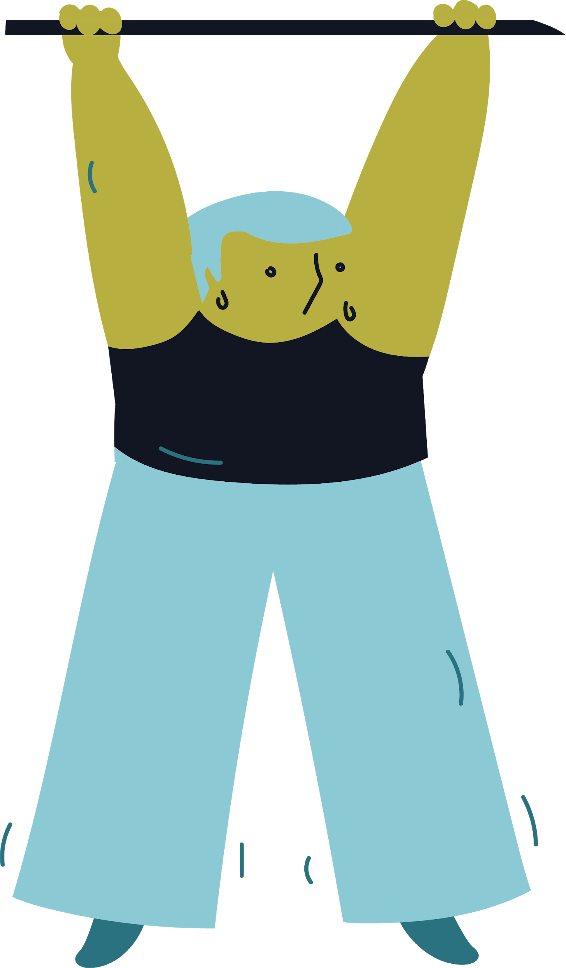
The key point about the continuum is that it is not level!
Lean / Fitness Continuum
This means that unless you proactively maintain lean/fitness oriented behaviours, you will slide down the continuum.
So finding ways to incentivise the right positive behaviours is critical to improving and sustaining your fitness or leanness.
Notes:
The key point about the continuum is that it is not level!
This means that unless you proactively maintain lean or fitness oriented behaviours, you will slide down the continuum.
So finding ways to incentivise the right positive behaviours is critical to improving and sustaining your fitness or leanness.

Slide 9
Core principles & many methodologies
Notes:
Core principles & many methodologies

Slide 10
Lean & fitness both have underlying core principles
Lean
Principles:
Optimise Flow
Understand Demand
Deliver value
Remove waste
Continuously improve
Engage & empower
Fitness
Principles:
Progression
Regularity
Overload
Variety
Recovery
Balance
Specificity
These are universally applicable to any person (fitness) or organisation (lean).
…though there are many underlying methods and techniques that align to these principles
Notes:
Lean & fitness both have underlying core principles.
These are universally applicable to any person (fitness) or organisation (lean).
…though there are many underlying methods and techniques that align to these principles

Slide 11
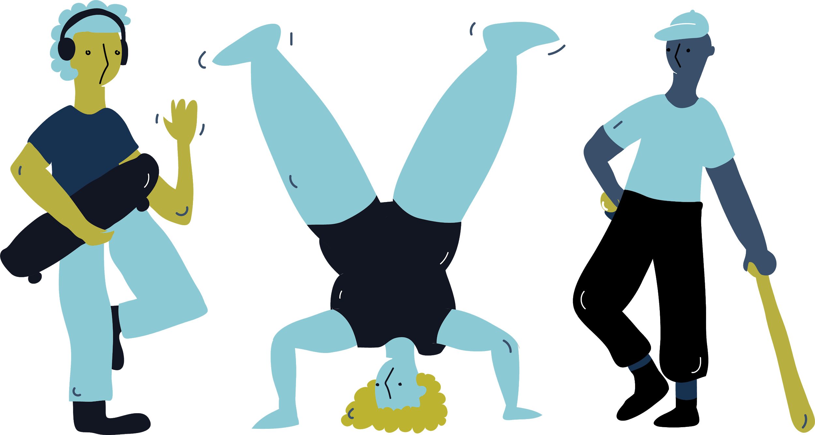
Consider the numerous fitness methods...
Notes:
Consider the numerous fitness methods...

Slide 12
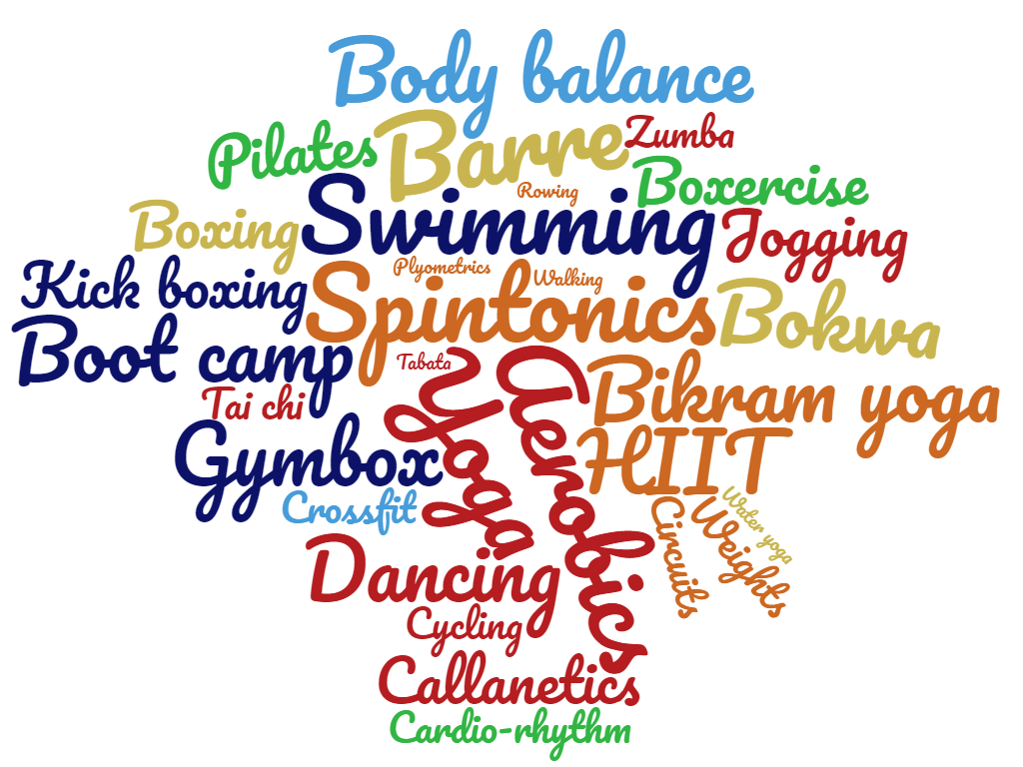
There are many exercise methods that align to core principles and deliver fitness for different types of sports and activities
Notes:
There are many exercise methods that align to core principles and deliver fitness for different types of sports and activities

Slide 13
Consider the various continuous improvement models and methods...
PDCA
TQM
Lean Thinking
Lean Six Sigma
Systems Thinking
Service Improvement
DMAIC
AMI
Operational Excellence
Lean Production
Continuous Improvement
Performance Excellence
STAR
VCPCIA
Appreciative Inquiry
Agile
Lean start up
Kata
And many more tools & techniques..
Notes:
Consider the various continuous improvement models, methods, acronyms and initialisms...

Slide 14
Your key lean/fitness decision*:
Which method(s) will enable me to become lean/fit so I can achieve my purpose effectively?
*Assuming you actually want to get fit or become lean…
Notes:
Your key lean/fitness decision* should be:
Which method(s) will enable me to become lean/fit so I can achieve my purpose effectively?
*Assuming you actually want to get fit or become lean…

Slide 15
If you failed to become fit or sustain your fitness, would you say that “fitness does not work?”
And if you failed to become lean or sustain your leanness, would you say that “lean does not work?”
No…you either: chose the wrong method, were not motivated sufficiently, were not supported enough, it was the wrong time, you were not ready…
Notes:
If you fail to become fit or sustain your fitness, would you say that “fitness does not work?”
And if you fail to become lean or sustain your leanness, would you say that “lean does not work?”
No…you either: chose the wrong method, were not motivated sufficiently, were not supported enough, it was the wrong time, you were not ready…

Slide 16
But what is sustainability?
Unconscious incompetence
Conscious incompetence
1
2
Unconscious Competence
Conscious Competence
4
3
Sustainability usually involves a journey from unconscious incompetence to unconscious competence - where being lean/fit becomes a habit.
Getting there takes discipline, time and effort!
Notes:
But what is sustainability?

Slide 17
No “one size fits all” solution
Notes:
3 - There is no “one size fits all” solution for lean and fitness

Slide 18
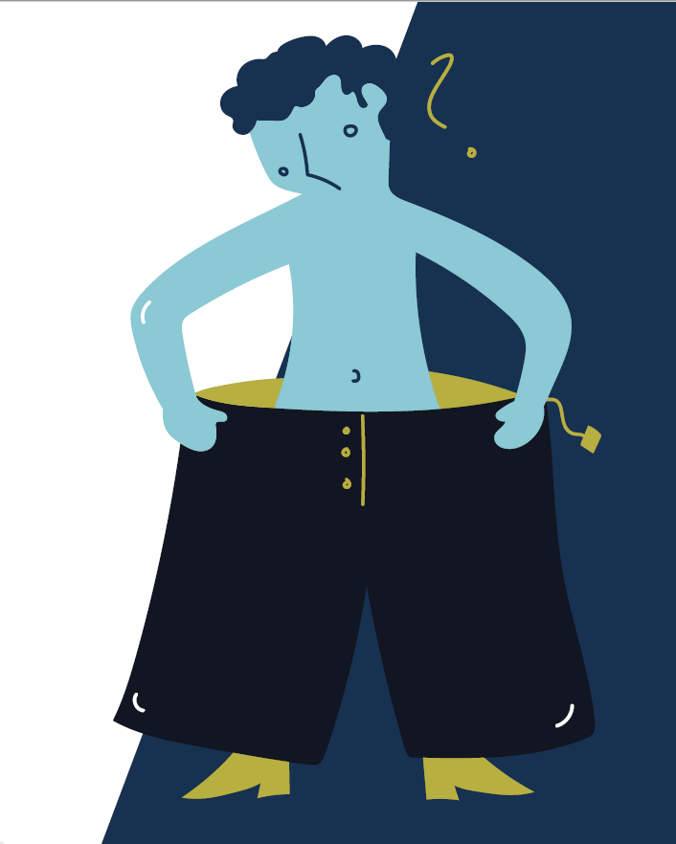
No “one size fits all” solution
When getting fit, we recognise we are all unique in our own ways and we all possess different attributes and characteristics.
So our chosen fitness/lean solution will depend on our circumstances.
Factors influencing our fitness approach:
Factors influencing our lean approach:
Age
Competition
Medical history
Lifestyle
Sport or activity
Physiology
Business sector
Process type
Size
Competition & market
Products
Customers
Notes:
When getting fit, we recognize we are all unique in our own ways and we all possess different attributes and characteristics.
So our chosen fitness solution will depend on our circumstances.

Slide 19
Both require a contingent approach
“Depending on or influenced by something else”
Non-prescriptive
No single best one way
Adaptable
Contextualised
Notes:
This suggests we need to adopt a contingent apprach to becoming lean or fit, which means “it all depends”

Slide 20
There are no quick fixes
Notes:
4 - there are no quick fixes

Slide 21
Lean & fitness are about incremental improvement over time
Success in lean/fitness is not about improving one thing 100%. It’s about improving
ninety nine things 1%.
Notes:
Lean & fitness are about incremental improvement over time and success in lean/fitness is not about improving one thing 100%. It’s about improving ninety nine things 1%.
There are no short cuts or silver bullets

Slide 22
However, there is room for the occasional radical breakthrough…
Dick Fosbury caused a paradigm shift in the high jump with his unique style of jumping.
He achieved a gold medal in the 1968 Olympics.
Occasionally radical breakthroughs will be needed in lean implementations.
Notes:
However, this does not mean that there is noroom for the occasional radical breakthrough…
Consider thgese the exception not the rule

Slide 23
Sound planning, support and a system perspective
Notes:
Number 5 - Sound planning, support and a system perspective

Slide 24
Success in fitness and lean is built on sound planning
Plans must be realistic, achievable, timely and aligned.
Clear objectives linked to purpose
Appropriate performance measures
Relevant critical success factors
Activity plans aligned to objectives
Notes:
Like most of life’s endeavours, success in fitness and lean is built on sound planning
Clear objectives linked to purpose
Appropriate performance measures
Relevant critical success factors
Activity plans aligned to objectives
Both lean and fitness need a clear plan if they are going to work. Plans must be realistic, achievable, timely and aligned.

Slide 25
Both need an integrated approach
The whole system needs to work together.
Fitness: not just specific muscles, but your whole body and even your mind.
Lean: not just the department, but also the value stream, the organisation and even the extended enterprise
Notes:
Both need an integrated approach
whic means considering the whole system The whole system needs to work together
You may need to start by focussing on a few critical areas
Fitness: not just your body, but also your mind
Lean: the value stream and extended enterprise

Slide 26
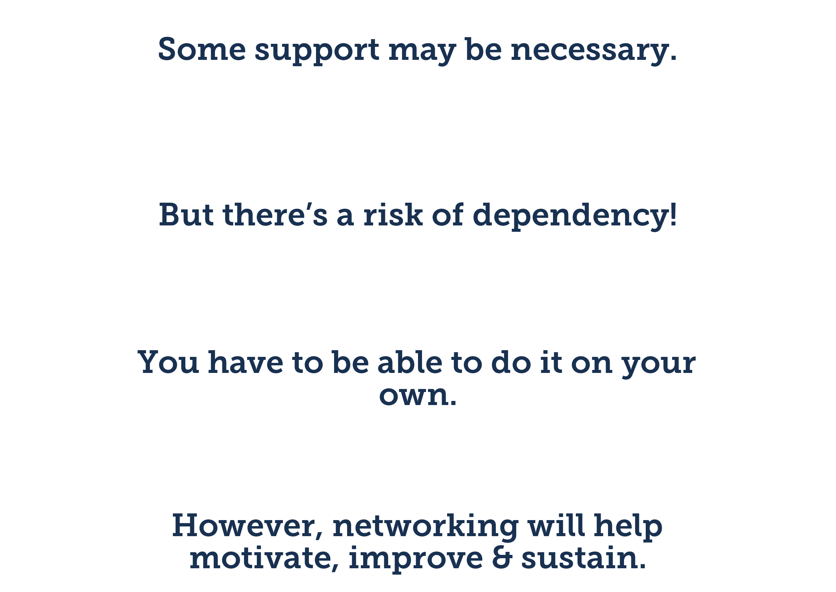
To help start the journey
Fitness and lean can both benefit from support
To learn from collaboration
To grasp the key skills
Ultimately, you must do it to yourself - not have it done to you.
To build self-confidence
To network & gain fresh ideas
Notes:
Fitness and lean can both benefit from support
Ultimately, you must do it to yourself - not have it done to you.

Slide 27
Motivation, positive thinking & recognition
Notes:
Six - Motivation, positive thinking & recognition

Slide 28
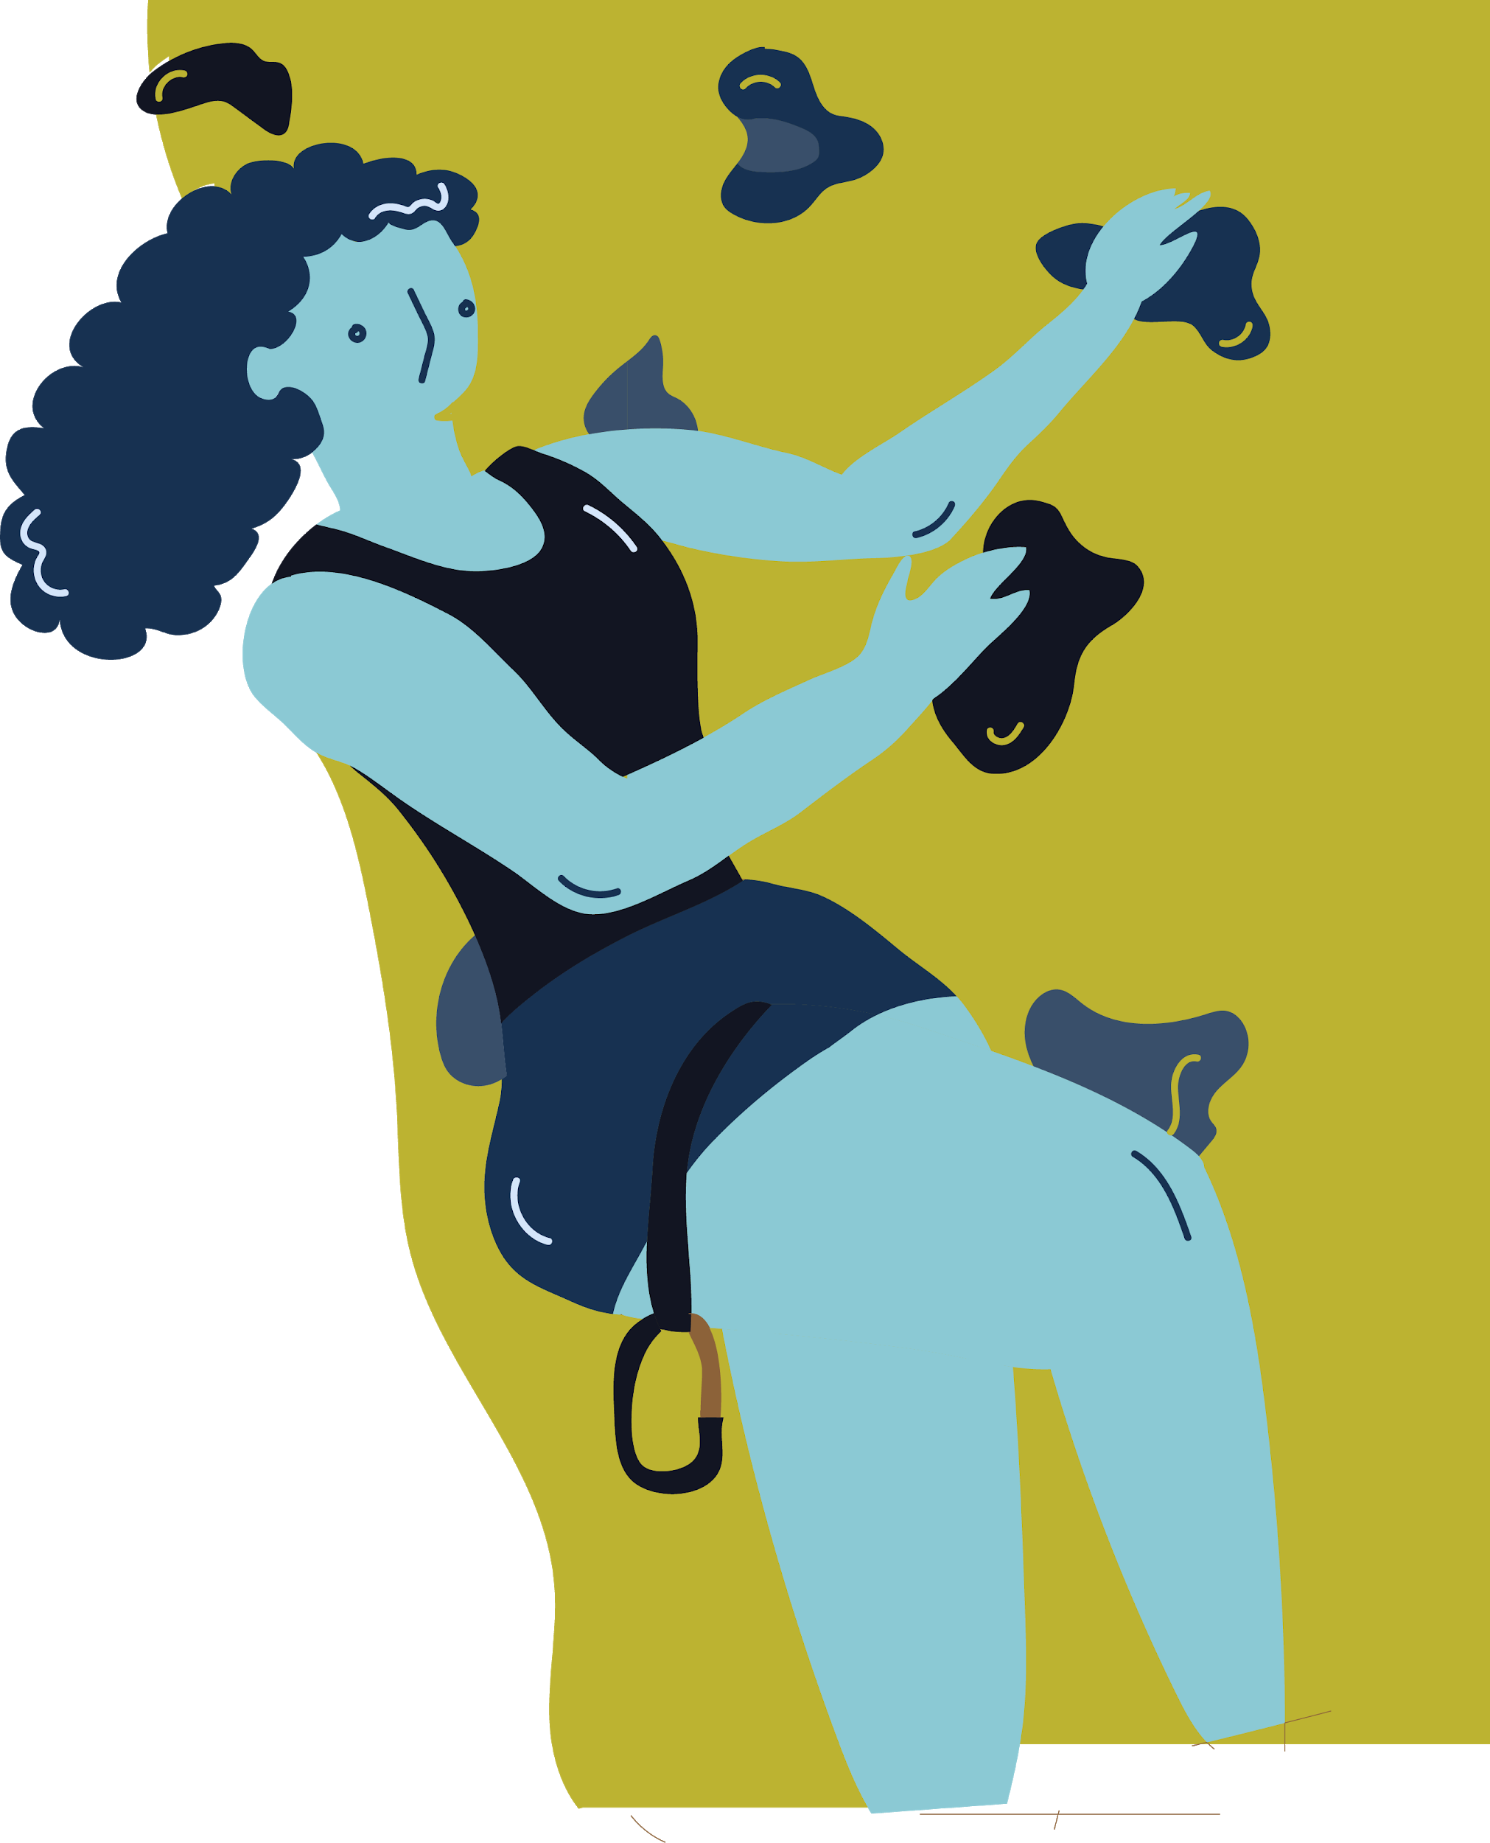
Motivation is key to both Lean & Fitness
You must want to do it!
Engaged in all aspects
Willingness to change and adapt
Keep setting higher goals
Don’t wait for your crisis.
What’s your motivation?
Notes:
Motivation is key to both Lean & Fitness
Don’t wait for your crisis.
What’s your motivation?
Create your own crisis
Sense of urgency

Slide 29
Positive thinking is key to Lean & Fitness
Consider the possibilities
Envisage success
Think half full, not half empty
Don’t be an anchor dragger
Attitude & Behaviour are critical!

Slide 30
Recognition & Reward in fitness & lean
For a sense of achievement and worth
For motivation
For sustainability
To celebrate success

Slide 31
So, are you ready?
You need to be prepared mentally and physically to embark on your fitness programme.
You need to be “organisationally ready” to go lean.
But don’t try too much, too soon!
Plan
Do
Check
Act

Slide 32
Summary: The Lean-Fitness Analogy
Dynamic states → no completion end-points
Purposively maintain the right behaviours → or you slip back
Key universal, high level principles → many underlying methods
Sustainability → requires developing unconscious habits
No one-size-fits-all solution → “contingent” approach
No quick fixes → incremental improvement over time
Planning & support → systemic approach
Reward → Intrinsic motivation is crucial
Means to an end → linked to an overall purpose

Slide 33
Just do it!
www.leancompetency.org

