Slide 1
Level 3 Programme Case Study Guide

Slide 2
Case Studies
Selection
Strategic Focus
Expectations
Lean nature
Structure
Writing the case
Assessment
Support & Review
Proposals Form
Discussion
Case study advisor: xxx
SUPPORTING RESOURCES
Guides, documents on web
Group interaction
Facilitator advice & feedback

Slide 3
Selecting Your Three Cases
First step - complete case study proposal form
Criteria
Strategic transformation – see below
No date constraint – but data accessibility
Clear learning opportunity
Linkage to career path (ref application form)
Developmental aspect
Experiential aspect
Linkage of cases optional

Slide 4
Strategic/Transformational Focus
Case focus: design, implement, sustain major system improvements, initiatives
Organisation, division/dept/group, extended enterprise
Role: significant management/leadership
Design, planning, managing people, communication, engagement, coordination, accountability, etc.
The project should have key strategic linkage & impact
aligned to organisational objectives, strategy, KPI’s

Slide 5
Critical Reflection
What happened (describe the experience)?
Why /how did it happen? What factors contributed? How do you feel about it?
What is your new interpretation of the experience? What is the significance? What did you learn about yourself and others?
What will you do as a result of this experience? How will you use it to inform your future?

Slide 6
Critical Thinking Skills
1. Knowledge
Identification & recall of information
List…identify…name…recall
Who, what, when, where?
2. Comprehension
Organisation & selection of facts & ideas
Convert…interpret…explain…retell
What is the main idea of…?
3. Application
Use of facts, rules & principles
Apply…solve…operate…conclude
Why is x significant?
4. Analysis
Separating a whole into component parts
Analyse…examine…deduct…specify
What evidence can you present for..?
5. Synthesis
Combining ideas to form a new whole
Construct…formulate…predict…suggest
What would/predict, infer from..?
6. Evaluation
Developing opinions, judgements & decisions
Appraise…judge…compare…opinion
How would you decide about…?
Ref: Bloom’s Taxonomy

Slide 7
Case Expectations
Demonstrates candidates own competency
‘Projects’ at a strategic/transformational level
Clear rationale for selection
Clear, logical structure
Narrative style – clear story emerges , “warts and all”
Critical thinking & personal reflection
Lessons learned
Knowledge transferable - communication

Slide 8
“Lean” Case
The word ‘lean’ does not have to feature explicitly in the project.
Business, process, operational excellence, CI etc
If the initiative aimed to achieve the following (not necessarily all), then it is suitable, eg:
Systemic transformation
Release/create capacity
Enhance, add value for customers, reduce waste
Improve throughput/flow, productivity
Improve quality; enhance capability

Slide 9
Case Study Structure
Recommended elements:
Executive Summary
Context, Aims, Role
Method & Approach
Analysis & Outcomes
Conclusions, Reflections & Sustainability,
Endorsement
NB Actual headings used may vary
PDCA cycle
Plan
Do
Check
Act
CRITICAL ANALYSIS & REFLECTION

Slide 10
Key Steps in Writing the case
What’s behind the case - context?
Core theme, storyline
Main area(s) of focus
Submit proposal(s)
Identify the case, outline proposal
Gathering information
Reports, presentations, A3’s etc
Contact colleagues, project participants
Recording thoughts – eg notes, diagrams, mind-maps*
Structuring the case
Key elements included
Ensure logical flow
Contents page can form basic structure
Create first draft
Turn notes, bullet points into paragraphs, add diagrams etc
Submit draft for review
Writing the report
Reviewing and redrafting
Take account of comments
Redraft
Proof reading by third party
Submit

Slide 11
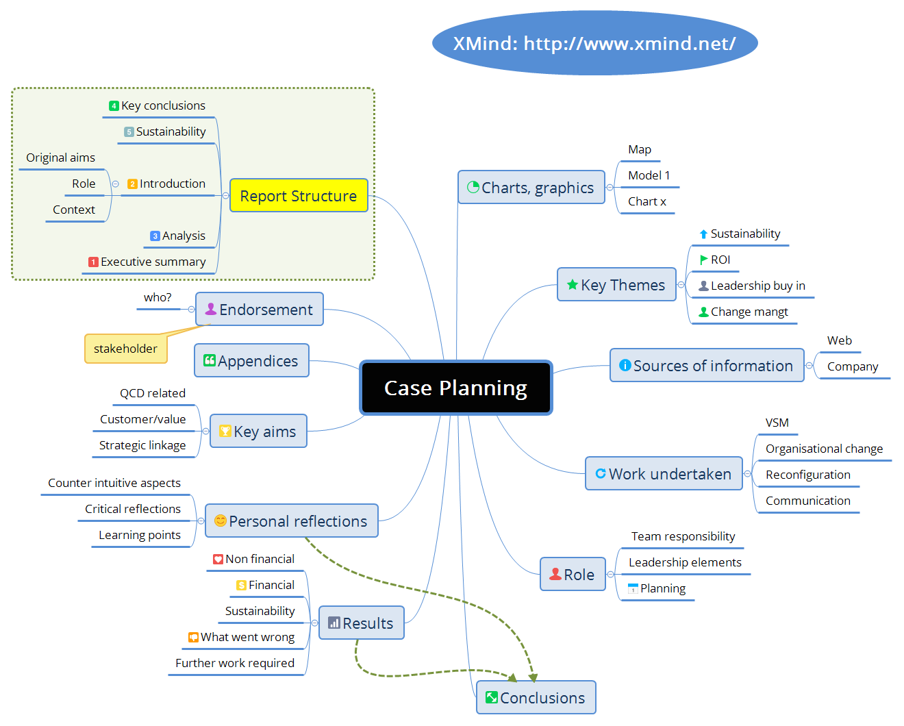

Slide 12
Writing Key Points
Make sure there’s a start – middle – end
Good narrative
flow, storyline
Concise language: minimise padding
Conclusion: logical consequence of what has gone before
Write in the first person if preferred
Include appropriate charts, diagrams etc
Effective communication
Conveys ideas effectively
Supplementary material in appendices
Use Word features (esp headings to create content tables)
About 12-15 pages in length plus appendices)

Slide 13
Case Assessment
Reflects recommended elements:
Executive Summary, Context, Aims, Role
Method & Approach*
Analysis & Outcomes*
Conclusions, Reflections & Sustainability*
Endorsement
* most important
Technical:
Good structure
Concise writing
Critical reflections
Personal insights & learning
Good use of diagrams
Quality of thinking

Slide 14
Support & Review
Proposal form submission & quick feedback
Write a substantial readable draft for initial review
Drafts should be emailed as MS Word documents, (not PDF).
One-to-one support reviewing & refining the cases
Written feedback plus group
Aim for 3 stages: initial draft – revised draft - final draft
Resources on group website
Review session TBA
Present case 1
Group scrutiny & discussion

Slide 15
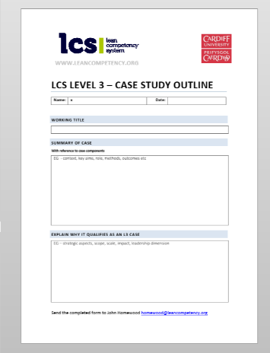
Case Proposals
Use form x3
Working Titles
Summary of cases
With reference to case components
Explain why it qualifies as a L3 case
One page in length
Date TBA

