Slide 1
Level 3 Programme Assignment Briefing October 2017

Slide 2
Agenda
Assignment aims & title
Overall theme and focus
Submission structure
Key points in writing
Reading and research
Timing, Review and Support

Slide 3
Level 3 Assignment: Summary
Aim: to formally assess the depth and maturity of lean/CI knowledge of the candidate
Allows the candidate to explore and consider personal interests and perspectives in lean thinking
Method: a 4,000 word written assignment
Demonstrates critical analysis & thinking
Background reading & research required
Guidance provided on approach, format, method etc

Slide 4
Critical Thinking
Critical Thinking
Interpretation
Analysis
Evaluation
Inference
Explanation
Self Regulation

Slide 5
Assignment Question & Key Points

Slide 6
Assignment Question
Discuss how lean thinking has evolved and developed since it was first popularised in the book The Machine that Changed the World to the present day. (25%)
Describe your approach to developing, implementing and leading lean initiatives in the light of this development and evolution. (25%)
Highlight particular themes, trends or issues that you think are relevant to lean’s future. (50%)
Note weighting of each part

Slide 7
Part A - Points to Consider
Demonstrate you have a clear understanding on how lean has evolved over the past three decades
Initial ‘definition’, focus, application and emphasis
Maturing definition of lean
Application in services and public services
New thinking challenging traditional lean orthodoxy
Lean at an enterprise level
Emergence of lean management & lean leadership
Extension of lean into new areas, functions
Lean ‘business system’, human and strategic dimensions

Slide 8
Part B - Points to Consider
Demonstrate that you have changed your approach to lean in the light of its evolution and your experiences
Informed by the cases
How has your approach changed? Why?
Use examples from cases and job roles

Slide 9
Part C - Points to Consider
Demonstrate your insights, critical thinking and strategic perspective.
Informed by the cases
Challenges in applying lean
Issues to be addressed
Opportunities
Option to focus on a particular area of interest or theme

Slide 10
Part C: Focus Areas
Recent Candidate Topics
Other ‘Hot’ Topics
RPA, AI
‘Fractal’ lean
Outsourcing
Personal lean
Sustainability
Corporate behaviour
Multi location, international, culture
Strategy
Leadership
Enterprise wide

Slide 11
Reading & Research

Slide 12
Reading
Large body of literature now available on lean thinking
See John Bicheno’s ‘Top 100 Lean Books”
Provides useful pointer to themes, topics and popularity
Several downloads are available on the L3 resources webpage
https://www.leancompetency.org/resources/l3-candidate-resources/
Password: L3p2017
Spend time using a search engine to explore material
Downloads, blogs, sites
Google Scholar also useful
a vehicle to search for academic literature
https://scholar.google.co.uk/schhp?hl=en&as_sdt=0,5

Slide 13
LCS L3 Assignment – Example Reading
The Machine that Changed the World, Womack, Jones & Roos
Staying Lean, Hines, Found, Harrison*
Lean Toolbox, (5th ed), Bicheno, Chapters 1 to 3, and final chapter
Service System Toolbox, Bicheno
Lean Thinking, (Womack & Jones) Part 1 in particular
Toyota Kata, Mike Rother, Parts I and II
The Toyota Way Fieldbook, Liker and Meier, Chapters 1 to 3
Creating a Lean Culture, David Mann, 2nd ed, Chapters 1 and 2
Learning to Evolve (paper), Hines et al*
Genealogy of Lean, (paper) Holweg*
Freedom from Command & Control, Seddon
The Lean CEO: Leading the Way to World-Class Excellence, Jacob Stoller
Real Lean (Vol 1), Bob Emiliani
*available as a PDF on LCS L3 resources page

Slide 14
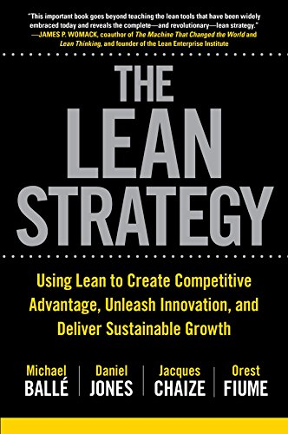
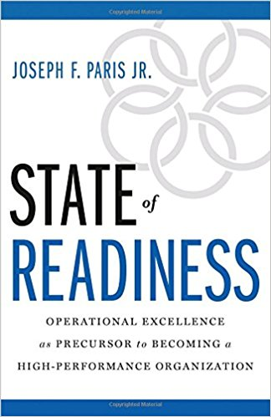
Recent Books
2017
2015
3 stars (out of 5) from John Bicheno
Review:
http://www.bobemiliani.com/book-review-the-lean-strategy/
2017

Slide 15
Notes about Assignment Writing

Slide 16
Steps in Producing the Assignment
Analysing the topic or question
What’s behind the question?
Core areas/topics
Main area(s) of focus
Reading and noting relevant material
Articles, reports, etc
Assignment reading list - books
On line material
Make notes – mind-maps, bulleted lists, post-its etc
Drawing up an assignment plan
Work to a defined structure; identify key sections
Rough sketch – basic plan – extended plan – evolving plan (outlining, ordering key points)
Writing the assignment
Turn notes, bullet points into paragraphs, narrative
Reviewing (SE)
Reviewing and redrafting
Ask someone to proof read
Read through in one go – overall flow, sense check
Have a cut off point!

Slide 17
Assignment Writing: Main Stages
Analyse the question
Make a rough outline plan (draft contents page)
Use plan to guide research & reading
Undertake research & reading
Review, revise and refine the plan
Write first draft
Edit draft for structure and content
Edit draft for style
Check referencing
Proof read for spelling/punctuation
Produce final copy

Slide 18
Characteristic of a Good Assignment
Clear introduction: outline the task and what’s about to come
Logical structure & organisation: flow
Analysis backed with facts
Contains original thinking, critical thinking, critical reflection
Balanced – appropriate amount on each key area
Not opinionated
Draws on your own work experiences

Slide 19
Characteristic of a Good Assignment
Language: written in third person
Succinct – minimal padding
Conclusion is a logical consequence of what has gone before
Referencing: acknowledge sources of information
Keeps to word count

Slide 20
Format
No prescriptive format; essay style – with narrative
Use of sections, sub-sections, headings, sub-headings OK
General broad structure:
Introduction
Mains aims, focus; brief description of what’s coming, main questions to be addressed
Main body
Divided into logical sections – Part 1, Part 2 etc
Conclusion/Summary
Link back to introduction, aims
Bring components together
Personal perspectives & insights

Slide 21
Using MS Word Effectively
Improve assignment writing efficiency
Use the Styles feature
Use of Headings feature
Automatically create tables of contents
Latest Office 365 Word version has referencing, bibliography, citation facilities

Slide 22
Reviewing & Support

Slide 23
Reviewing
Prof Pauline Found main assessor
Send to SE for comment & review:
Outline plan/contents page
Theme, focus
Specific draft sections
Complete draft
Also, queries on any aspect.
Peer reviewing - > discussion group
Target date from submission: TBA

