Slide 1
Level 3 Programme Kick Off Meeting
Date

Slide 2
Kick Off Session Aims
Understand the programme background & components
Appreciate the importance of critical thinking in L3 submissions
Understand the process to develop case studies
Understand the case study structure and format
Know about the support available
Know the immediate actions to start the programme
Next Steps for the Cohort Group

Slide 3
Who’s Who
xxx
John Homewood

Slide 4
Note on Confidentiality
All submitted material remains confidential and will not be distributed or communicated in any way outside of the LCS
Formal NDA agreement can be signed if necessary

Slide 5
Level 3 Introduction

Slide 6
LCS Levels
Seven levels of competency
Fundamental to Strategic
3b
Advanced lean/CI knowledge.
Strategic and leadership competencies required for senior lean leadership.
Demonstrating lean leadership qualities and practices.
3a
2b
2a
1c
1b
1a

Slide 7
L3 Programme Focus
Not an academic qualification!
Focus on practice
Mature & broad lean knowledge implicit
Focus on leadership
Strategic, transformational dimension – enterprise wide or supply chain dimension
Personal development through:
Critical reflection & review
Self study: reading, researching

Slide 8
Lean Leadership Competencies
The ability to think in terms of processes, value streams and systems; knowing how to lead systems.
The ability to problem solve, understand variability and waste
Understanding how we learn, develop and improve; leading learning & improvement
Understanding the behaviour of people
Giving vision, focus and direction to the organisation
Adapted from Scholtes, 1998

Slide 9
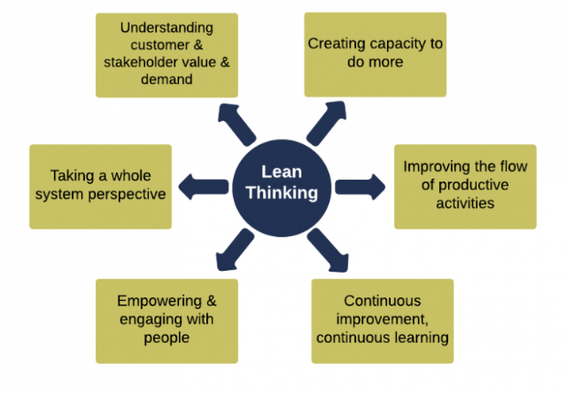
LCS Approach to Lean
Holistic, eclectic definition of lean
Lean = delivering appropriate customer and stakeholder value with the minimum of resources.

Slide 10
Gaining Level 3
A candidate provides evidence that demonstrates:
Significant experience in designing, leading, implementing lean strategies/ transformations/ programmes
A progressive and mature understanding of lean thinking and related improvement philosophies and their associated tools and techniques.

Slide 11
L3 Focus: Critical Thinking & Reflection
Candidate encouraged to:
Be constructively critical of situations & themselves
Be challenging
Offer opinions for future strategies, approaches, directions
Critical reflection is:
A reasoning process to make meaning of an experience.
An activity during which we challenge the validity and appropriateness of our assumptions and beliefs within our present context
The process of looking back on what has been done and pondering on it and learning lessons from what did or did not work.

Slide 12
Critical Reflection
What happened (describe the experience)?
What will you do as a result of this experience? How will you use it to inform your future?
Why /how did it happen? What factors contributed? How do you feel about it?
What is your new interpretation of the experience? What is the significance? What did you learn about yourself and others?

Slide 13
Overall L3 Process & Components

Slide 14
Level 3 Programme Components
L3 Programme
c. 9 months to complete → max 12 months
Group or individual path
Evidence Portfolio
Application
Advisor Support & Guidance
Case studies x3
Up to 12 months
Assignment
Panel

Slide 15
Level 3 Programme Components
L3 Programme
c. 9 months to complete → max 12 months
Group or individual path
Evidence Portfolio
Application
Advisor Support & Guidance
Case studies x3
Up to 12 months
Assignment
Panel

Slide 16
Programme Components
...
Experience - Employment history (app form)
Implementation case studies x3
Assignment
Panel Presentation

Slide 17
L3 Process Summary
Application Approval
Kick off Session
Planning
Candidate Work & Output
Personal Timetable
Case Proposals
Case 1 - initial focus, style feedback
Cases 2 & 3
Background reading & research for assignment (can start immediately)
Main work on assignment starts after cases completed
Panel presentation - shaped and informed by cases and assignment
Timetable
Case Proposals
Cases x3
Coaching & Feedback
Assignment
Assignment outline
Panel presentation
Overall assessment; certificate awarded

Slide 18
L3 Process Summary
Kick off Session
Planning
Activities not strictly linear
Case #1 - initial focus
Cases #2 & #3 - can be worked on simultaneously
Background reading & research for assignment can start immediately
Main work on assignment starts after cases completed
Panel presentation → shaped by cases and assignment
Cases x3
Assignment
Panel presentation
Overall assessment; certificate awarded

Slide 19
Case Studies
Three cases of lean implementation projects, initiatives, programmes.
3rd case option: future case → ‘payback’
Illustrating particular elements of your lean competence & leadership
Experience developed in a strategic or transformational context
Relating to the long-term & overall aims of an organisation and its purpose
Looking to illustrate your development and lessons you learnt

Slide 20
Case Studies
Three cases of lean implementation projects, initiatives, programmes
Strategic and/or transformational in nature:
“Relating to the identification of long-term or overall aims and interests and the means of achieving them”
“The plans made or the actions taken in an effort to help the organisation fulfil its intended purpose“
As opposed to TACTICAL: short term, less important/size
Cases discussion later in session

Slide 21
Level 3 Assignment
Aim: to assess candidate’s depth and maturity of lean/CI knowledge
Method: a 4,000 word assignment
Demonstrate critical thinking
Personal perspective on lean
Focus on a key aspect, theme or issue of interest
Reading & research required
Guidance provided on approach, format, method etc
Title will relate to the evolution and development of lean thinking and includes discussing a theme/topic of interest of the candidate.

Slide 22
Panel Presentation
Panel members
LCS, academics/practitioners, organisation representative
1.5 hours → inc discussion, questions
Physical or Online meeting
Candidate brings together the two major elements of the programme and considers impact on future lean strategy, lean thinking development and personal lean approach.
Knowledge
Practice

Slide 23
Case Studies

Slide 24
Case Studies
Approaches
Strategic
“Lean”
Key steps in writing the case
Assessment
Support & Review
Proposal Form
Case structure/format
Critical reflection
Case study advisor: Dr John Homewood
SUPPORTING RESOURCES
Guides, documents in cloud folder
Advisor advice & feedback

Slide 25
Case Study Approaches
Case 1: Early Experience
Case 2: Building Experience
Case 3: Current or Future Context
Opportunity explore your significant improvement practice and leadership, reflect what sparked you into action and motivated you.
First case also helps case study writing development
Maybe a few years later, interesting and new challenges, reflecting on your own leadership maturity and understanding behaviour of others
Relating to recent or current role, organisation or project, using insights from previous cases and placing in the context of the here-and-now, with critical reflection
Future context...

Slide 26
Case Studies - Payback Option
NEW!
Case 1: Early Experience
Case 2: Building Experience
Case 3: Payback Case
Opportunity explore your significant improvement practice and leadership, reflect what sparked you into action and motivated you.
First case also helps case study writing development
Maybe a few years later, interesting and new challenges, reflecting on your own leadership maturity and understanding behaviour of others
Addresses the need for a clear return on personal development investment.
Integrates the L3 programme with the candidate’s current role.

Slide 27
L3 Process - Payback Model
Kick off Session
Planning
Personal Timetable
Case Proposals
Case 1 - initial focus, style feedback
Case 2 - More experiential case material
Background reading & research for assignment (can start immediately)
Main work on Assignment starts after cases completed
Case 3: ‘Payback Project’ Briefing
Panel presentation - shaped & informed by cases, assignment and payback project briefing
Payback Project is initiated, in business
Review of initiation and certification confirmation
Cases x2
Assignment
‘Payback Case’ 3 Briefing
Panel presentation & Case proposal
Overall assessment: Provisional Certificate
Case 3 Initiated:
Certificate Confirmed

Slide 28
Selecting Your Three Cases
First step - complete case study outline form
Criteria
Strategic transformation – see below
No date constraint – but data accessibility
Clear learning opportunity
Linkage to career path (ref application form)
Developmental aspect
Experiential aspect
Linkage of cases to each other optional

Slide 29
Strategic/Transformational Level
Focus: design, implement, sustain major system improvements, initiatives
Organisation, division/dept/group, extended enterprise
Your role: significant management/leadership
Design, planning, managing people, communication, engagement, coordination, accountability, etc.
Case should demonstrates candidates own competency
The case should have key strategic linkage & impact
aligned to organisational objectives, strategy, KPI’s

Slide 30
“Lean” Case
The word ‘lean’ does not have to feature explicitly in the project.
Business, process, operational excellence, CI etc
If it aimed to achieve the following (not necessarily all), then it is suitable, eg:
Systemic transformation
Release/create capacity
Enhance, add value for customers, reduce waste
Improve throughput/flow, productivity
Improve quality; enhance capability

Slide 31
Key Steps in Writing the Case - EG
What’s behind the case - context?
Core theme, storyline
Main area of focus
Submit outline form
Identify the case, outline proposal
Gathering information
Reports, presentations, A3’s etc
Contact colleagues, project participants if possible
Recording thoughts – eg notes, diagrams, mind-maps*
Structuring the case
Follow the standard structure → see template
Consider its logical flow
Create first draft
Turn notes, bullet points into paragraphs, add diagrams etc
Submit draft for review
Writing the case report
Reviewing and redrafting
Take account of comments
Redraft
Proof reading by third party
Submit

Slide 32
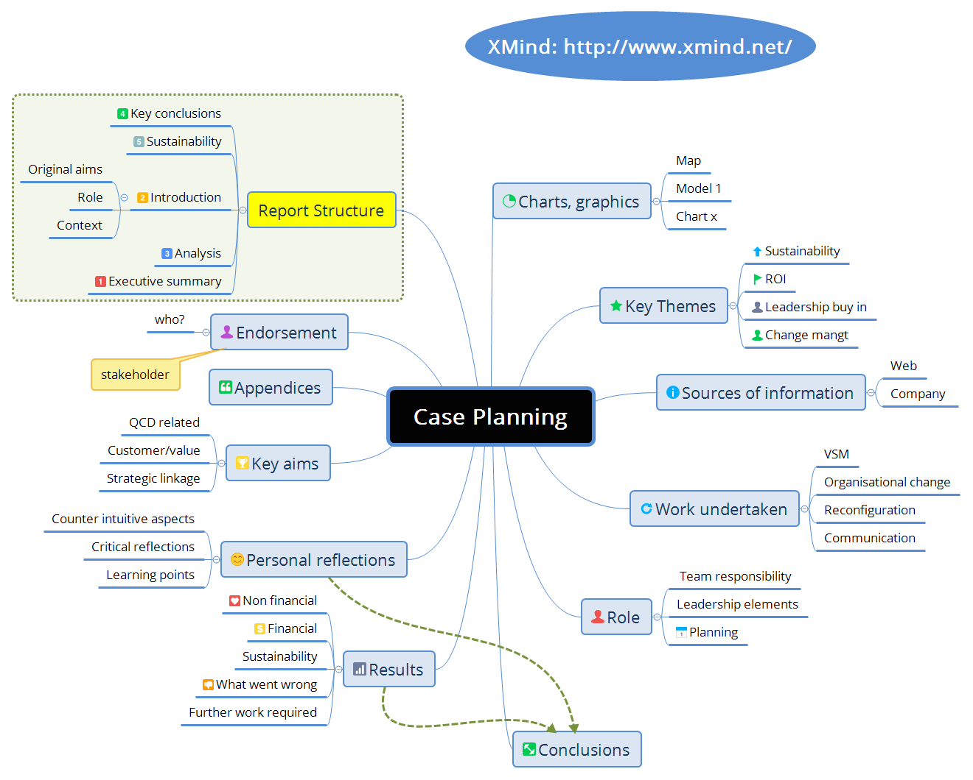
Example case planning mind map

Slide 33
Writing Key Points
Follow the section headings & guidelines
Concise language, keep narrative flowing → avoid ‘padding’
Conclusion: should be a logical consequence of what has gone before
Write in the first person if preferred
Include charts, diagrams etc
Supplementary material can be in an appendix and copies added to the folder
Length: core document 10 to 15 pages → “less is more…”
Supporting/background material can be uploaded to the folder

Slide 34
Third Case Option: Future Focus
A new project linked to the candidate’s current role
drawing on insights from previous cases & assignment
Address an initiative of strategic importance
clear strategic benefit & tangible return
Project plan presented at panel presentation
Documents the analysis, design & initiation of a live case
Payback expectation part of the plan
Project initiation marks confirmation of certification
Opportunity for ongoing LCS contact
EG continual learning, knowledge dissemination

Slide 35
Case Assessment
Keeping to the case structure
Introduction
Method & Approach
Analysis & Results
Conclusions & Sustainability
Critical Reflections
Quality of organisation & flow of narrative
Quality of critical thinking, personal insights & learning

Slide 36
Support & Review
Case outline form completion & quick feedback
One-to-one support reviewing & refining the cases
Aim for 3 main stages:
initial draft
revised draft
final version
LCS may send reminders or request for status update
Use Google Docs documents in L3 Folder
Comment/review facility will be used – ideally no emailing!

Slide 37
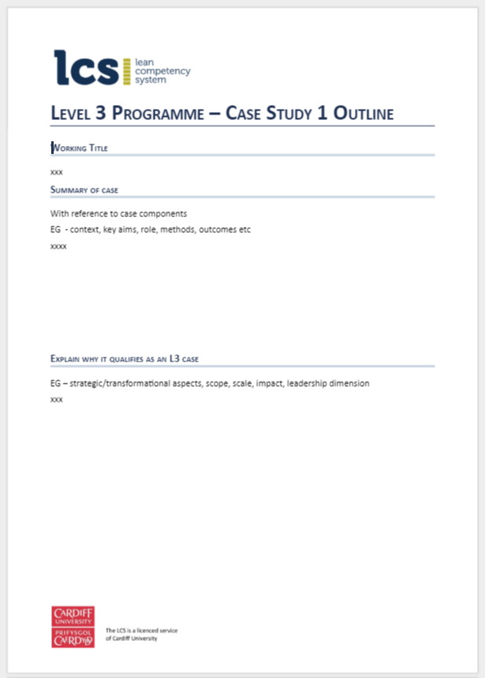
Case Proposals
Use case study outline form x3
Working Title
Summary of cases
Explain why it qualifies as a L3 case
One page in length
Copies in L3 Folder

Slide 38
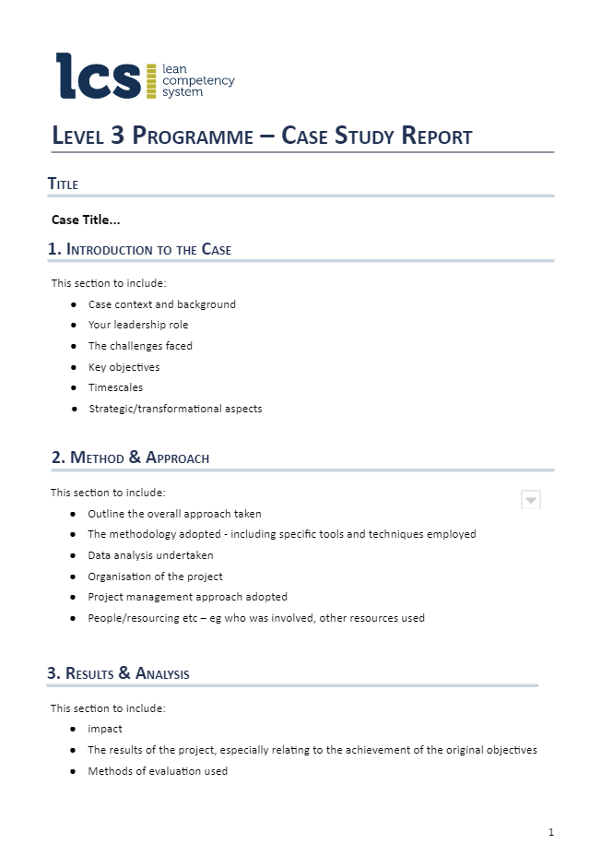
Case Structure & Format
Use case study report template (in L3 folder)
Introduction
Method & Approach
Analysis & Results
Conclusions & Sustainability
Critical Reflection: 3 explicit questions to address
Supporting documents
Guidelines for each section
Three critical reflection questions to address
Supporting documents can be included
Upload to folder

Slide 39
Critical Reflection I
How did the Case Experience Impact on Your Approach to Leadership?
Items to consider - how it may have affected:
Your personal leadership style
Your appreciation of your strengths and weaknesses
Your approach to managing change
The way you communicate - orally or written
How you motivate people
How you foster staff/team engagement in the changes
Your approach to guiding, coaching or mentoring

Slide 40
Critical Reflection II
How did the Case Experience Impact the Way you Apply Lean Thinking?
Items to consider - how it may have affected:
Your overall methodology or model for applying lean
Your use of tools & techniques
The pace at which you implement lean
Your consideration of the prerequisites for sustaining lean initiatives
The way you communicate lean thinking
How you implement a lean plan or strategy
I

Slide 41
Critical Reflection III
How did the Case Experience Impact on Your Understanding of Lean Thinking?
Items to consider - how it may have affected:
Your view of how lean thinking is evolving
The challenges facing lean thinking
How you define lean thinking
Your thoughts on lean’s applicability in different contexts
Your view on how adaptable lean is.

Slide 42
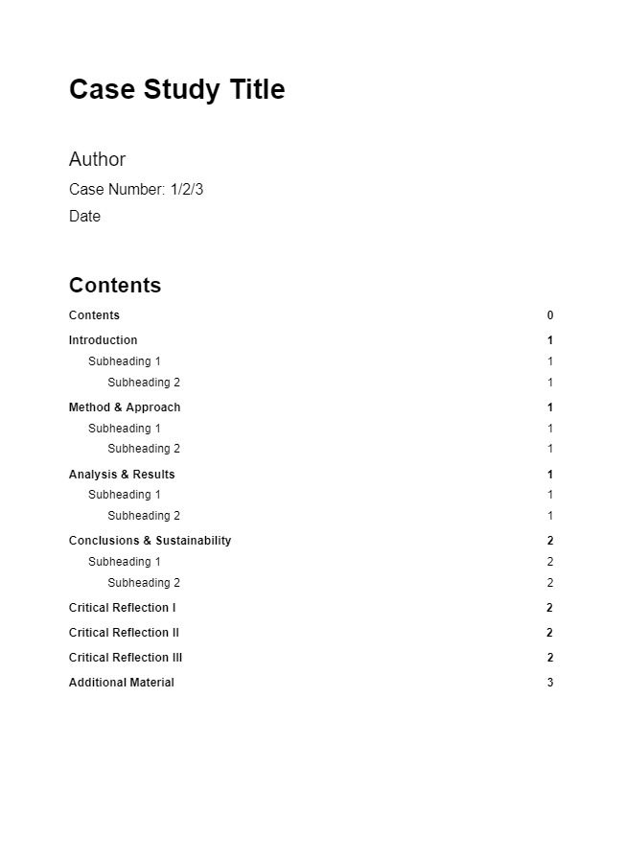
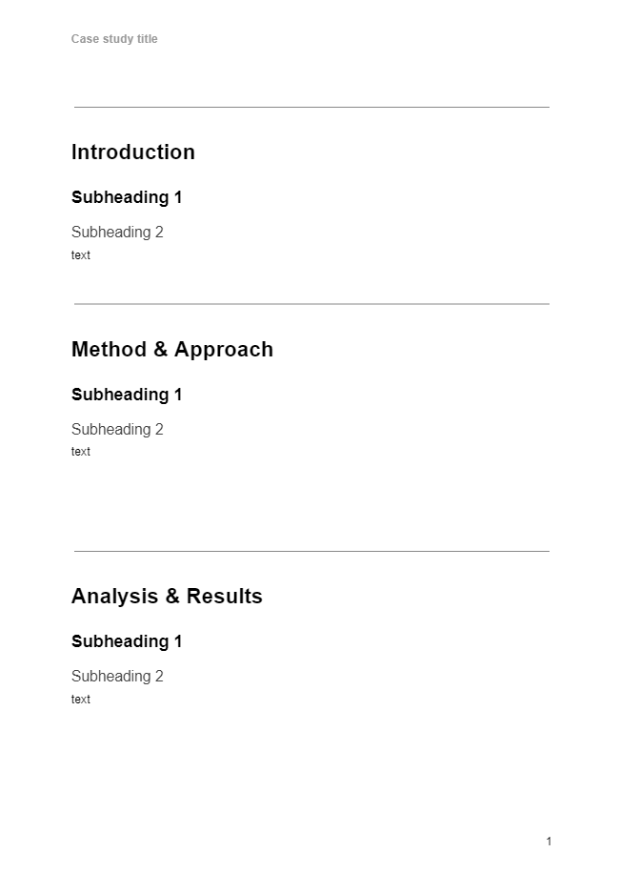
Case Study Template
Template available L3 folder
Can type directly into a cloud document
Useful collaboration features
Comment & review facility used by advisor

Slide 43
Timetable

Slide 44
Timetable: Targets
Identify target finish date: Month, Year
Milestones for cases
Assignment start date
Provisional panel date
Sessions introducing each element & reviewing - individual sessions
Action: devise timetable → see template in folder
NOTE: Be realistic in setting dates: holidays, personal, work commitments

Slide 45
Timetable Template 1
Activity | Date
KO session | xxx
Case proposals x3 (using form) | xxx
Feedback on proposals | xxx
Develop draft case 1 | xxx
Submission of draft case 1 | xxx
Submit case 1 | xxx
Cases 2 & 3 development (with feedback) | xxx
Cases 2 & 3 submission | xxx
Assignment briefing session (web) | xxx

Slide 46
Timetable Template 2
Activity | Date
Assignment development (with feedback) | xxx
Submit assignment | xxx
Panel briefing session (web) | xxx
Candidate prepares presentations | xxx
Panel | xxx
Final Candidate Assessment Report issued | xxx
Certificate awarded | xxx

Slide 47
Support & Resources

Slide 48
Support & Guidance
One-to-one support from LCS advisor
Web sessions introducing the different programme elements - group or individual
Ad hoc email, phone contact
Network with other L3 candidates:
LCS website private discussion forum (tba)
L3 Google Drive folder

Slide 49
L3 Information Management & Collaboration
Personal L3 programme folder in Google Drive
All work can take place ‘in the cloud’
Google Docs templates available
L3 candidate can update & creates documents in folder
NB: you can work on Google files offline
Supporting information can be added to the folder
LCS assessors can access all & comment

Slide 50
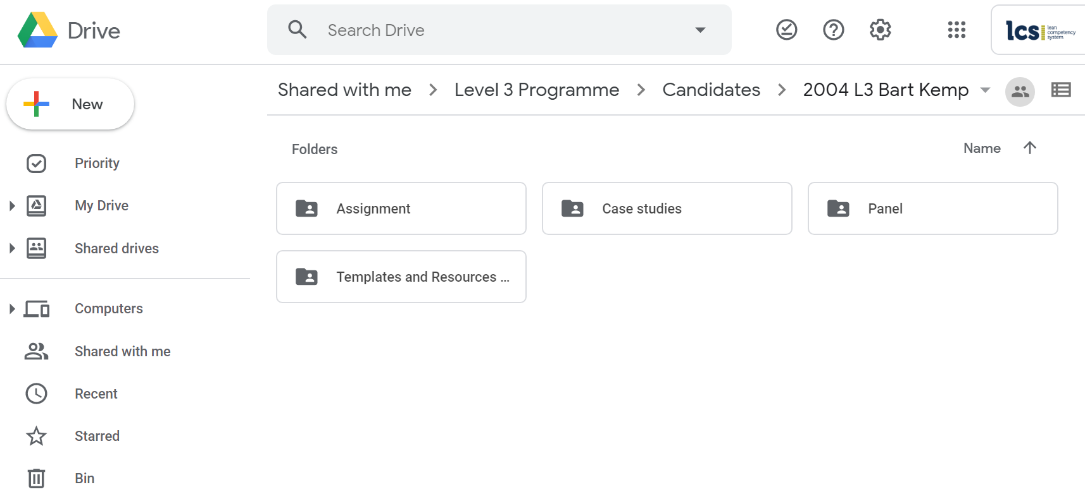
Google Drive
Master folder → your name
Sub folders contain key documents
Resources folder → templates, guides, presentations, etc

Slide 51
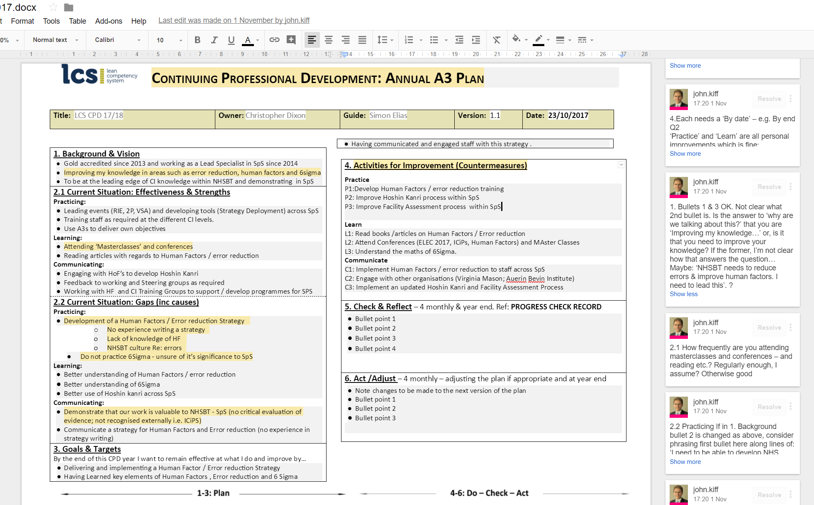
Review & Comment
Remarks by assessors made directly onto document using Google Docs Comments feature
Comments can be replied to, edited and resolved.
A history of all comments kept
Automatic notification of document changes

Slide 52
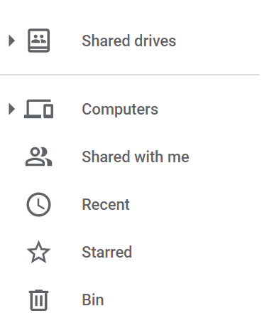
Google Drive Set Up
Initiated by LCS
You receive an invite to access your folder
Full editing capability
You will need a (free) Google Drive account
Though you do not need to have Gmail
Your L3 folder will be under ‘Shared with me’ in your Google Drive

Slide 53
Actions

Slide 54
Next Steps: LCS
Grant access to Google Drive (LCS)
Check access OK (Candidates)
Invoice raised (LCS)

Slide 55
L3 Process Summary
Application Approval
Kick off Session
Planning
Candidate Work & Output
Personal Timetable
Case Proposals
Case 1 - initial focus, style feedback
Cases 2 & 3
Background reading & research for assignment (can start immediately)
Main work on assignment starts after cases completed
Panel presentation - shaped and informed by cases and assignment
Timetable
Case Proposals
Cases x3
Assignment
Assignment outline
Panel presentation
Overall assessment; certificate awarded

Slide 56
Timetable Template 1 example
Activity | Date
KO session | 16/07/21
Case proposals x3 (using form) | End July 2021?
Feedback on proposals | Beginning Aug 2021
Develop draft case 1 | Aug/Sep 2021
Submission of draft case 1 | 30/09/21
Submit case 1 | 31/10/21
Cases 2 & 3 development (with feedback) | 31/11/22
Cases 2 & 3 submission | 31/12/22
Assignment briefing session (web) | Jan 2022

Slide 57
Timetable Template 2 example
Activity | Date
Assignment development (with feedback) | Feb 2022
Submit assignment | Early March 2022
Panel briefing session (web) | Mid March 2022
Candidate prepares presentations | End March 2022
Panel | April 2022
Final Candidate Assessment Report issued | April 2022
Certificate awarded | May 2022

Slide 58
Case Proposals
Use case study outline form x3
Working Title
Summary of cases
Explain why it qualifies as a L3 case
One page in length
Copies in L3 Folder

Slide 59
Next Steps: Candidates
Timetable: Version 1 (Candidates)
To File / JAH
Case study proposals (Candidates)
To File / JAH
Activity | Date
KO session | xxx
Case proposals x3 (using form) | xxx
Feedback on proposals | xxx
Develop draft case 1 | xxx
Submission of draft case 1 | xxx
Submit case 1 | xxx
Cases 2 & 3 development (with feedback) | xxx
Cases 2 & 3 submission | xxx
Assignment briefing session (web) | xxx
Activity | Date
Assignment development (with feedback) | xxx
Submit assignment | xxx
Panel briefing session (web) | xxx
Candidate prepares presentations | xxx
Panel | xxx
Final Candidate Assessment Report issued | xxx
Certificate awarded | xxx

