Slide 1
Level 3 Programme Assignment Briefing
August 2021

Slide 2
Contents
Assignment aims & question
Reading & research
Planning & writing the assignment
Support & review

Slide 3
Level 3 Assignment: Summary
Aim: to formally assess the depth and maturity of lean/CI knowledge of the candidate
Allows the candidate to explore and consider personal interests and perspectives in lean thinking
Demonstrates critical analysis, reflection & thinking
Method: a 4,000 word written assignment
Background reading & research required
Guidance provided on approach, format, method etc

Slide 4
Critical Thinking
Interpretation
Self Regulation
Analysis
Critical Thinking
Explanation
Evaluation
Inference

Slide 5
Assignment Question & Key Points

Slide 6
Assignment Question
Discuss how lean thinking has evolved and developed since it was first popularised in the book The Machine that Changed the World to the present day. (25%)
Describe your approach to developing, implementing and leading lean initiatives in the light of this development and evolution. (25%)
Highlight particular themes, trends or issues that you think are relevant to lean’s future. (50%)
Note weighting of each part

Slide 7
Part A - Points to Consider
Demonstrate you have a clear understanding on how lean has evolved over the past three decades
Initial ‘definition’, focus, application and emphasis
Maturing definition of lean
Application in services and public services
New thinking challenging traditional lean orthodoxy
Lean at an enterprise level
Emergence of lean management & lean leadership
Extension of lean into new areas, functions
Lean ‘business system’, human and strategic dimensions

Slide 8
Part B - Points to Consider
Describe how your understanding of, and approach to, implementing lean thinking has changed in the light of its evolution and your implementation experiences
Informed by the cases
How has your approach changed? Why?
Use examples from cases and job roles

Slide 9
Part C - Points to Consider
Demonstrate your insights and strategic perspective by highlighting particular themes, trends or issues of interest that you think are relevant to lean’s future.
Informed by the cases and personal experience
Challenges in applying lean
Issues to be addressed
Opportunities
Option to focus on a particular area of interest or theme

Slide 10
Part C: Focus Areas
Recent Candidate Topics
Other ‘Hot’ Topics
RPA, AI
‘Fractal’ lean
Outsourcing
Personal lean
Standardisation in services
Lean’s failure in services
Sustainability
Corporate behaviour
Multi location, international, culture
Strategy
Leadership
Enterprise wide
Industry 4.0

Slide 11
Reading & Research

Slide 12
Reading
Large body of literature now available on lean thinking
See John Bicheno’s ‘Top 100 Lean Books”
Provides useful pointer to themes, topics and popularity
Several downloads are available in the L3 resources area
Spend time using a search engine to explore material
Downloads, blogs, sites
Google Scholar also useful
a vehicle to search for academic literature
https://scholar.google.co.uk/schhp?hl=en&as_sdt=0,5

Slide 13
LCS L3 Assignment – Example Reading
The Machine that Changed the World, Womack, Jones & Roos
Staying Lean, Hines, Found, Harrison*
Lean Toolbox, (5th ed), Bicheno, Chapters 1 to 3, and final chapter
Service System Toolbox, Bicheno
Lean Thinking, (Womack & Jones) Part 1 in particular
Toyota Kata, Mike Rother, Parts I and II
The Toyota Way Fieldbook, Liker and Meier, Chapters 1 to 3
Creating a Lean Culture, David Mann, 2nd ed, Chapters 1 and 2
Learning to Evolve (paper), Hines et al*
Genealogy of Lean, (paper) Holweg*
Freedom from Command & Control, Seddon
The Lean CEO: Leading the Way to World-Class Excellence, Jacob Stoller
Real Lean (Vol 1), Bob Emiliani
*available as a PDF on LCS site

Slide 14
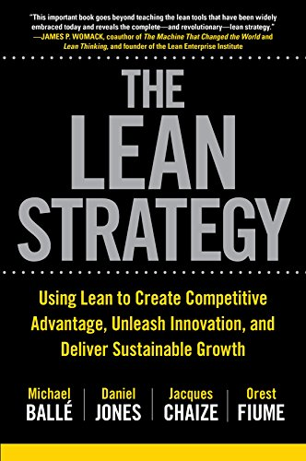
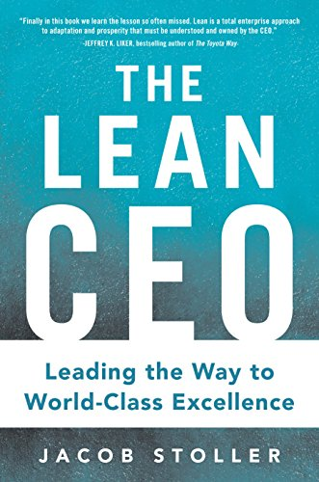
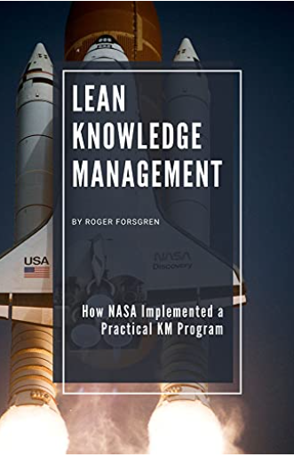
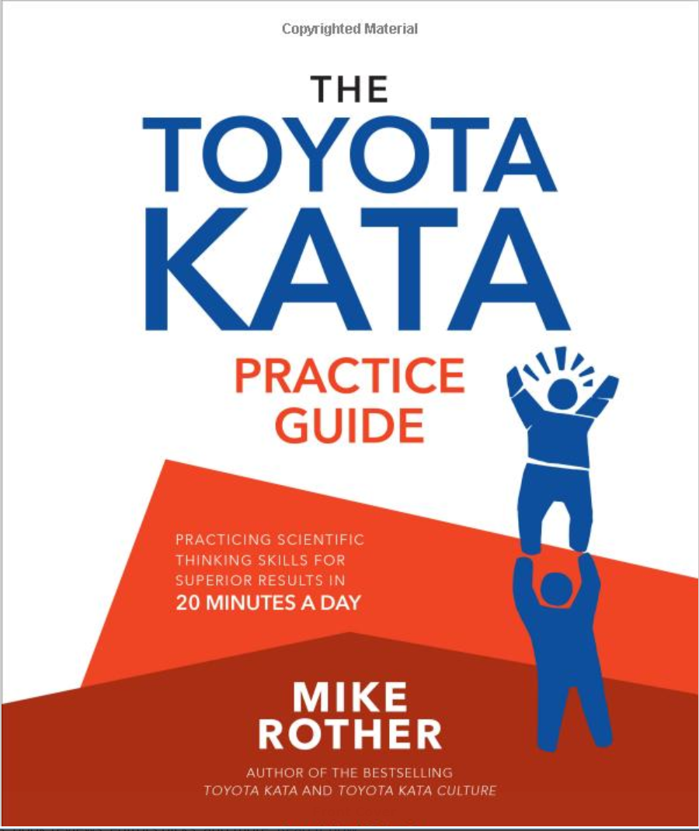
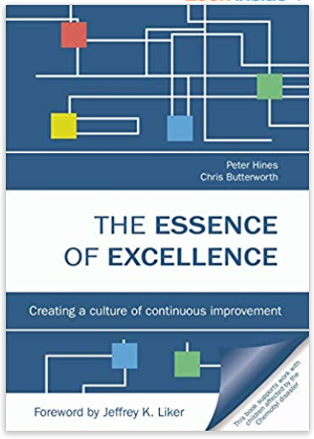
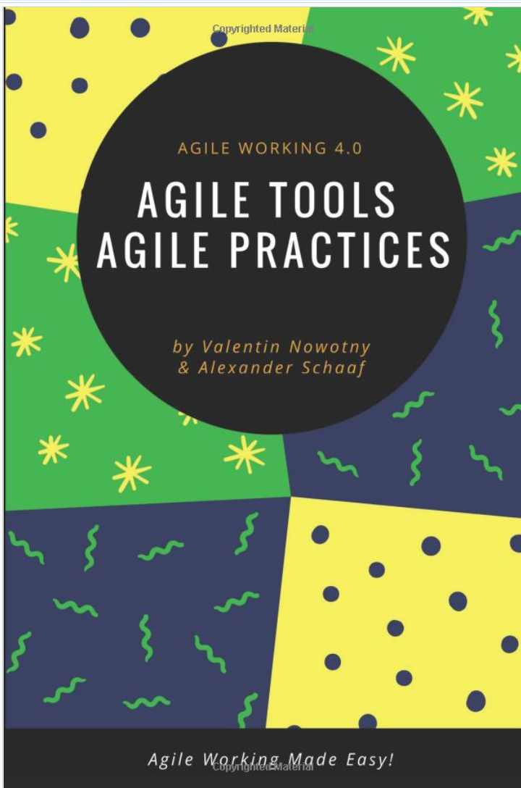
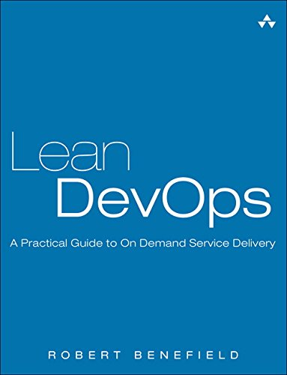
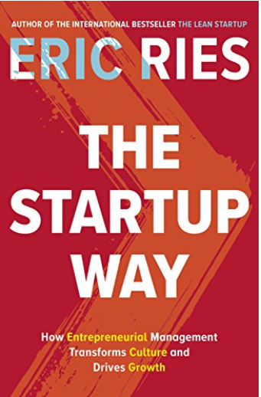
Some Recent Themes
2017
2015
2021
2015
2017
Review:
http://www.bobemiliani.com/book-review-the-lean-strategy/
2017
2019
2018
Coming soon!
2019

Slide 15
Planning & Writing the Assignment

Slide 16
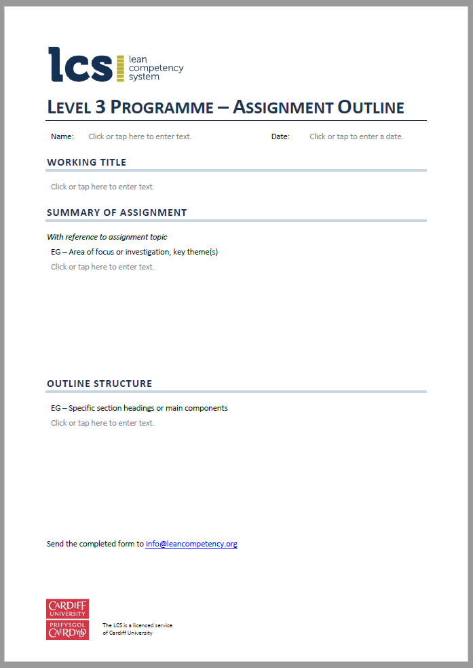
1st Step: Produce Assignment Outline
Use template
Working title
Overall summary
Area of focus or investigation, key themes, topic of personal interest
Outline structure
Main sections, sub-sections
Send to LCS for review/discussion 🡪 endorsement
Update L3 programme timetable

Slide 17
Steps in Producing the Assignment
Analysing the question
What’s behind the question?
Weighting of different components
Area of personal of focus
Articles, reports, etc
Assignment reading list - books
Online material
Make notes – mind-maps, bulleted lists, post-its etc
Reading and noting relevant material
Based on your initial Assignment Outline
Based on LCS assignment structure; note main sections
Rough sketch 🡪 basic plan 🡪 detailed plan
Contents page: add and periodically update
Review & feedback
Drawing up an assignment plan
Writing the assignment
Turn notes, bullets into sections, sub sections, paragraphs
Reviewing & feedback
Thorough proofreading! Referencing
Review for good flow, general ‘sense check’
Have a cut off point!
Reviewing and redrafting

Slide 18
Characteristic of a Good Assignment
Clear introduction: summarise what’s about to come (not conclusions)
Good structure/organisation, flow
Analysis backed with facts – is not too opinionated
Original thinking, critical reflection
Appropriate amount on each key section
Draws on work experiences
Clear conclusion
Referenced appropriately

Slide 19
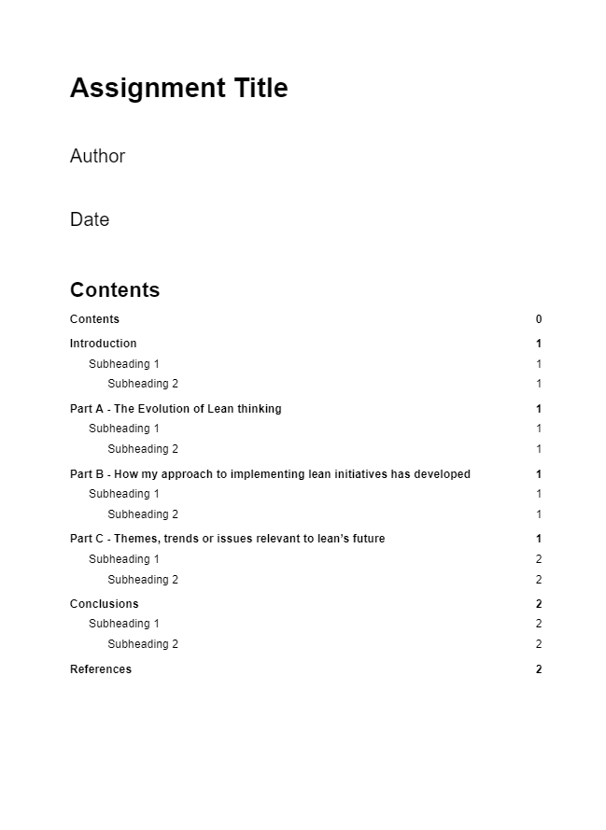
Format
Use the LCS L3 assignment format
Sections & sub-sections
Structure follows assignment question:
Introduction, Parts A, B & C, Conclusion
Guidance provided at the start of each section
Template in the cloud folder
Work in the cloud folder for efficient review and feedback

Slide 20
Referencing
You should reference appropriately
When you use material that has not originated with you.
Eg factual information, data, images, opinion, direct quotation, or when you summarise or paraphrase the work of others.

Slide 21
Reviewing & Support

Slide 22
Reviewing
Level 3 advisor to guide, comment & review - eg
Endorse Assignment Outline
Review drafts - specific sections
Review final draft
Agree expectations regarding review input
Eg frequency, method
‘Comment’ facility on Google Docs is very useful and efficient
Note role of advisor is guidance – not a joint piece of work!
Target date from submission should be in timetable

