Slide 1
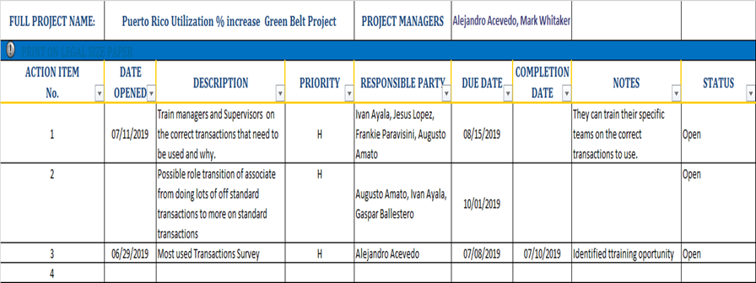
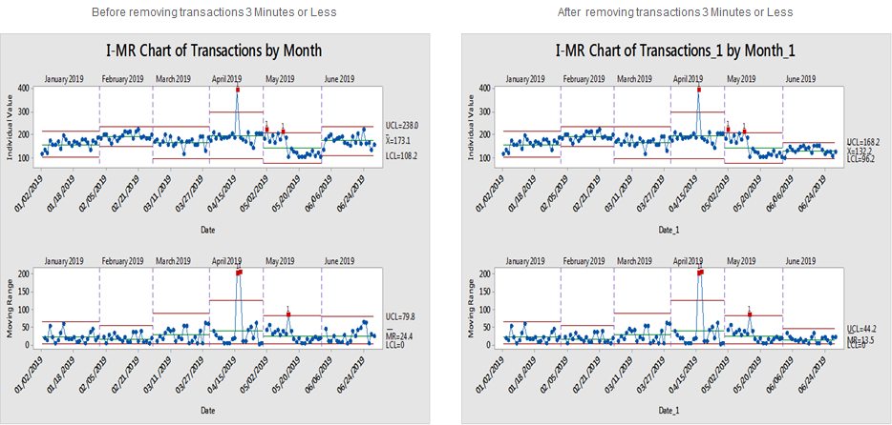
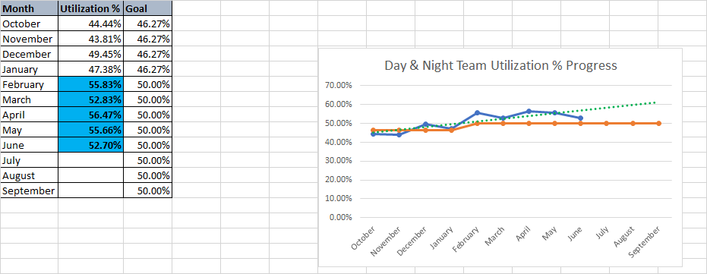
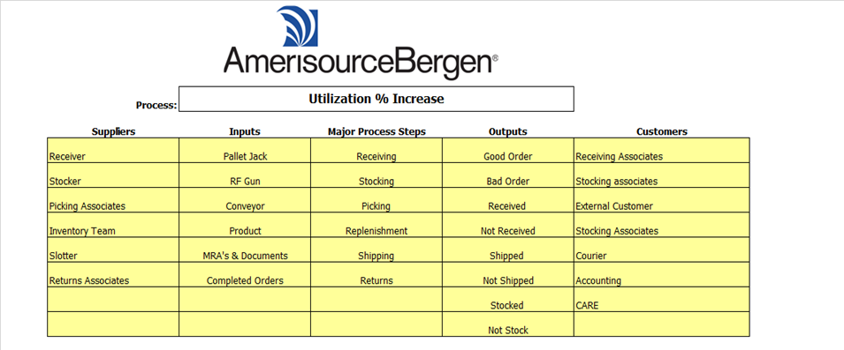
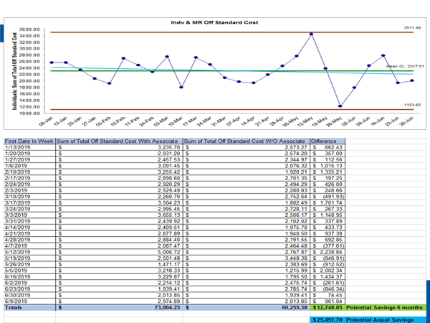
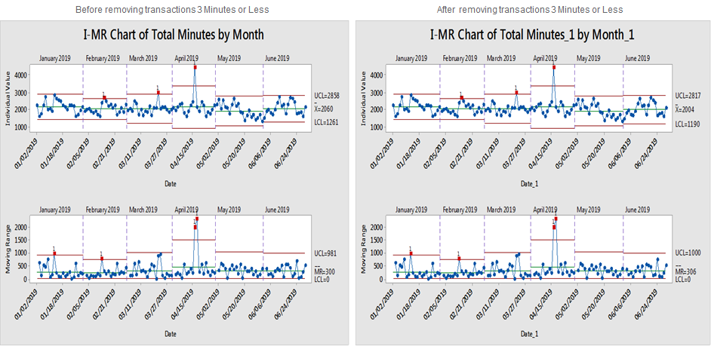
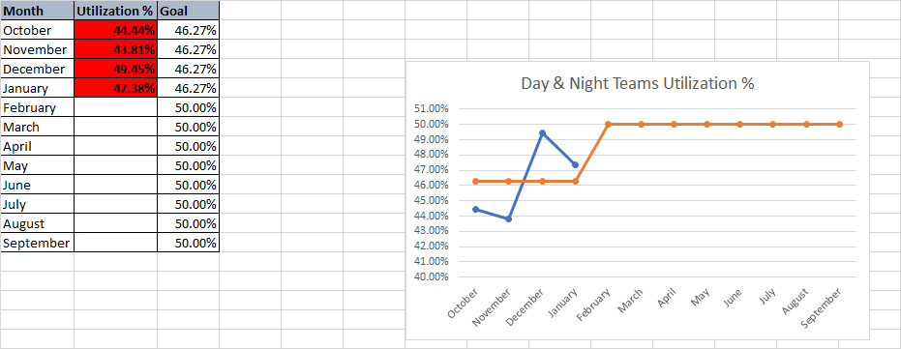
Puerto Rico DC Utilization % Increase- Project A3
6. Action Items List
Improve
Segment/Business Unit : Puerto Rico DC /South East District
Project Sponsor: Augusto Amato
Project Leader: Alejandro Acevedo
Kaizen Coach: Mark Whitaker
Core Team: Jesus Lopez, Alejandro Acevedo, Augusto Amato, Ivan Ayala, Irma Medina
3. Team Created a Process Map
Measure
Identify The Problem:
Define
The Puerto Rico DC has identified that its operations are currently performing with a low utilization Percentage of 44%. Utilization % measures the time the associates are doing work in the warehouse that is measurable. A cross functional team has been developed to find opportunities to increase this Metric. During the Team meetings, the DMAIC process was followed and the team was able to use the tools at hand like: PROCESS MAPS, FISHBONE DIAGRAM, QUICK KAIZEN etc. To help identify root cause and opportunities to improve Utilization % n the Distribution Center.
Key Action Items
Train Managers and Supervisors on the correct transactions that need to be used and why.
Most used transaction survey
Associate role transition
4. Analyzed Amount of Off Standard Transactions
Analyze
7. Implement Countermeasures:
Control
The process changes have led to help decrease the use of and time on Off standard transactions. This has helped us reach and pass the goal of 50% to 54.7%
Measure
2. Grasp The Current Situation:
Team completed a SIPOC and process map to see the opportunities available.
Measure
2. Grasp The Current Situation:
Team a SIPOC and processed mapped the Returns to Vendor process to identify the opportunities.
Financials
5. Analyzed Amount of Time on Off Standard Transactions :
Analyze
3. Grasp The Current Situation:

