Slide 1
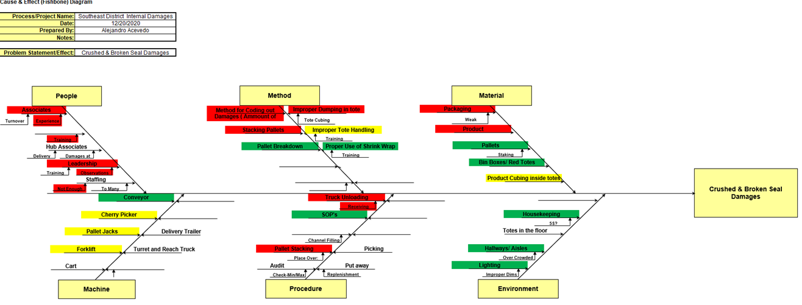
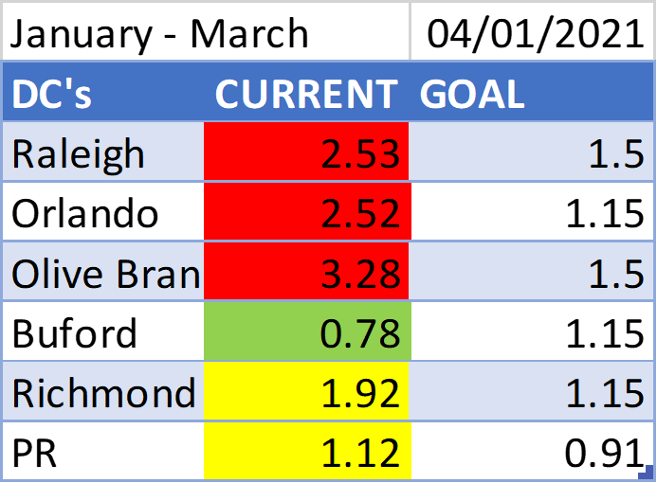
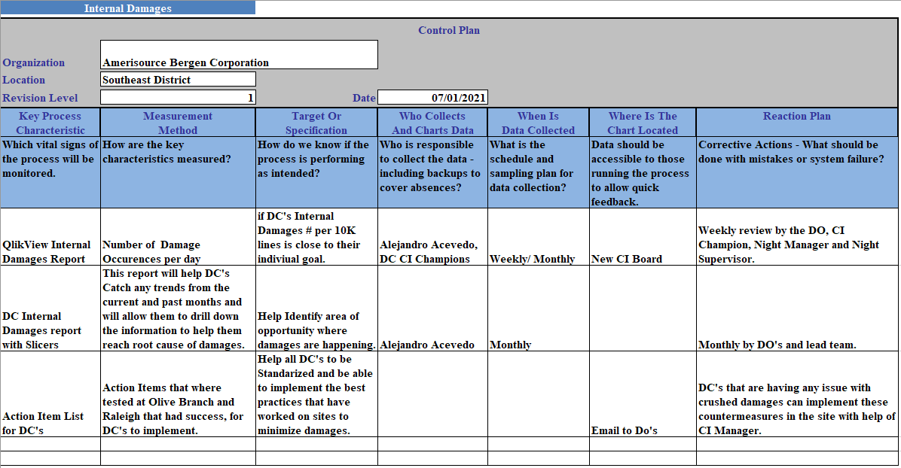
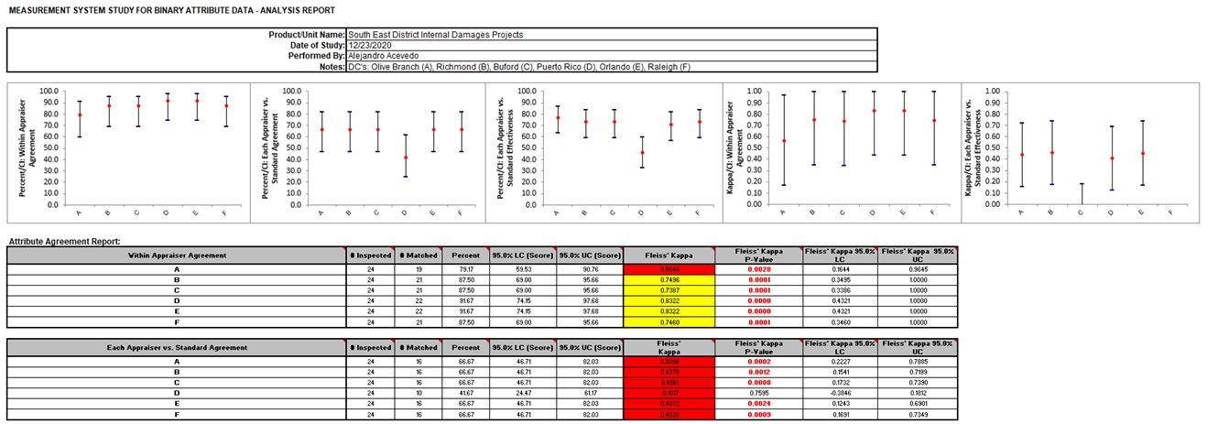
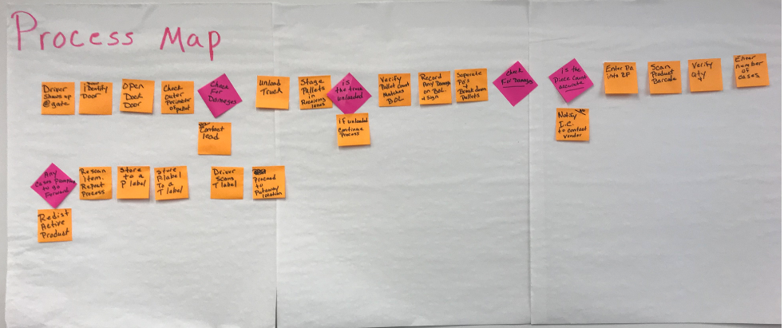
Title: Internal Damages (Southeast District) | Owner | Alejandro Acevedo, CI Manager Southeast District | Date | 7/09/2021
Background
The Southeast District has been performing very well in this metrics but still has some work to do to reach company goal. We can see that some DCs are having success and in order to lower this metric as a district we need to copy best practices from these top performing Dc’s as a universal strategy to lower Internal damages in all DC’s and help lower the Districts metric below 1.2
Continued-Analysis
Key Takeaways:
1- Coaching Opportunity for Correct damage coding.
2- Managers, Supervisors and Leads need to be very aware in receiving, so damages are not received in the DC.
3- Make sure associates are trained to properly dump product in tote. (Use Aprons)
4- Need to Identify product that are with weak packaging prone to being crushed.
5- Create One Point Lessons for training associates on Chariot use.
Process Owner: Jeff Rehovsky
Black Belt: Alejandro Acevedo
Master Black Belt: Mark Whitaker
Other Team Members: Mike Irwin, Melissa Taylor, Neil Groseclose, Bob Armstrong, Kelly Arnold, William Lee, Oscar Fernandez
Current Condition
Proposed Countermeasures
Southeast district was at 2.02 damages per 10K lines at beginning of project.
Last Fiscal Year district was at 1.93 damages per 10K lines. Data has shown a high
Number of damages as crushed and broken seal.
-After a few meetings with Olive Branch and Raleigh, a few ideas were identified as action items to help minimize these Crushed Damages.
6S Receiving Area: identify area to use for inspections of vendors that have had most damages according to report.
Implement 100% use of Chariots according to SOP and document trained associates. Creation of One Point Lessons for this training is recommended.
Select specific Team that will always handle put away.
Minimize number of Associates allowed to code out damages in the WH. Olive Branch Reduced from 30+ associates to 10.
DC’s need to be in conversation with FedEx, UPS, XPO so they are handling our deliveries with proper care.
Goals/Targets
By start of 2021 Fiscal year new improvements should be in place so that all DC’s in the district can improve the metric. Goal is to lower Southeast district from 2.02 damages/ 10k overall to or below 1.2 damages/ 10k. Our secondary metrics are Damage occurrences for Broken Seal, Crushed. We are currently at 1604 occurrences and the goal is to be at 1449 or less occurrences by the end of the project. Potential Savings: $140K or more.
Achievements
Control Plan
1- The Southeast District has been able to improve its Internal damages from 2.02 per 10K lines to 1.35 per 10k lines.
2- its has been able to reduce the use of Crushed code from 40% 1st 3 months of the year, down to 30% overall for the district the past 3 months. Olive Branch and Raleigh have both achieved their goals.
Analysis
Process Mapping Sessions: Multiple process mapping sessions were conducted and Team concentrated efforts on the Receiving process to identify waste in process that would reveal root cause to crushed items.
Survey &MSA: While analyzing data, we noticed a lot of question on How to properly code a Damage. Information from the Survey was used to do a measurement systems analysis. This revealed that across the District we where not standardized in the way we code out damages.

